Slide 1
ETHICAL HACKING INTERNSHIP
Project by
Jyothis.B

Slide 2
Task 1

Slide 3
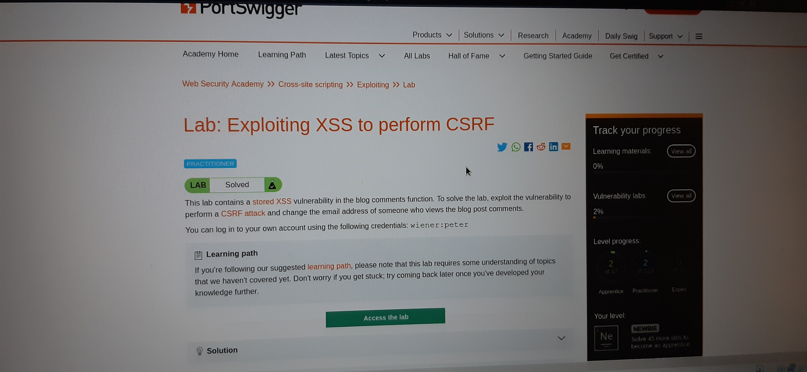

Slide 4
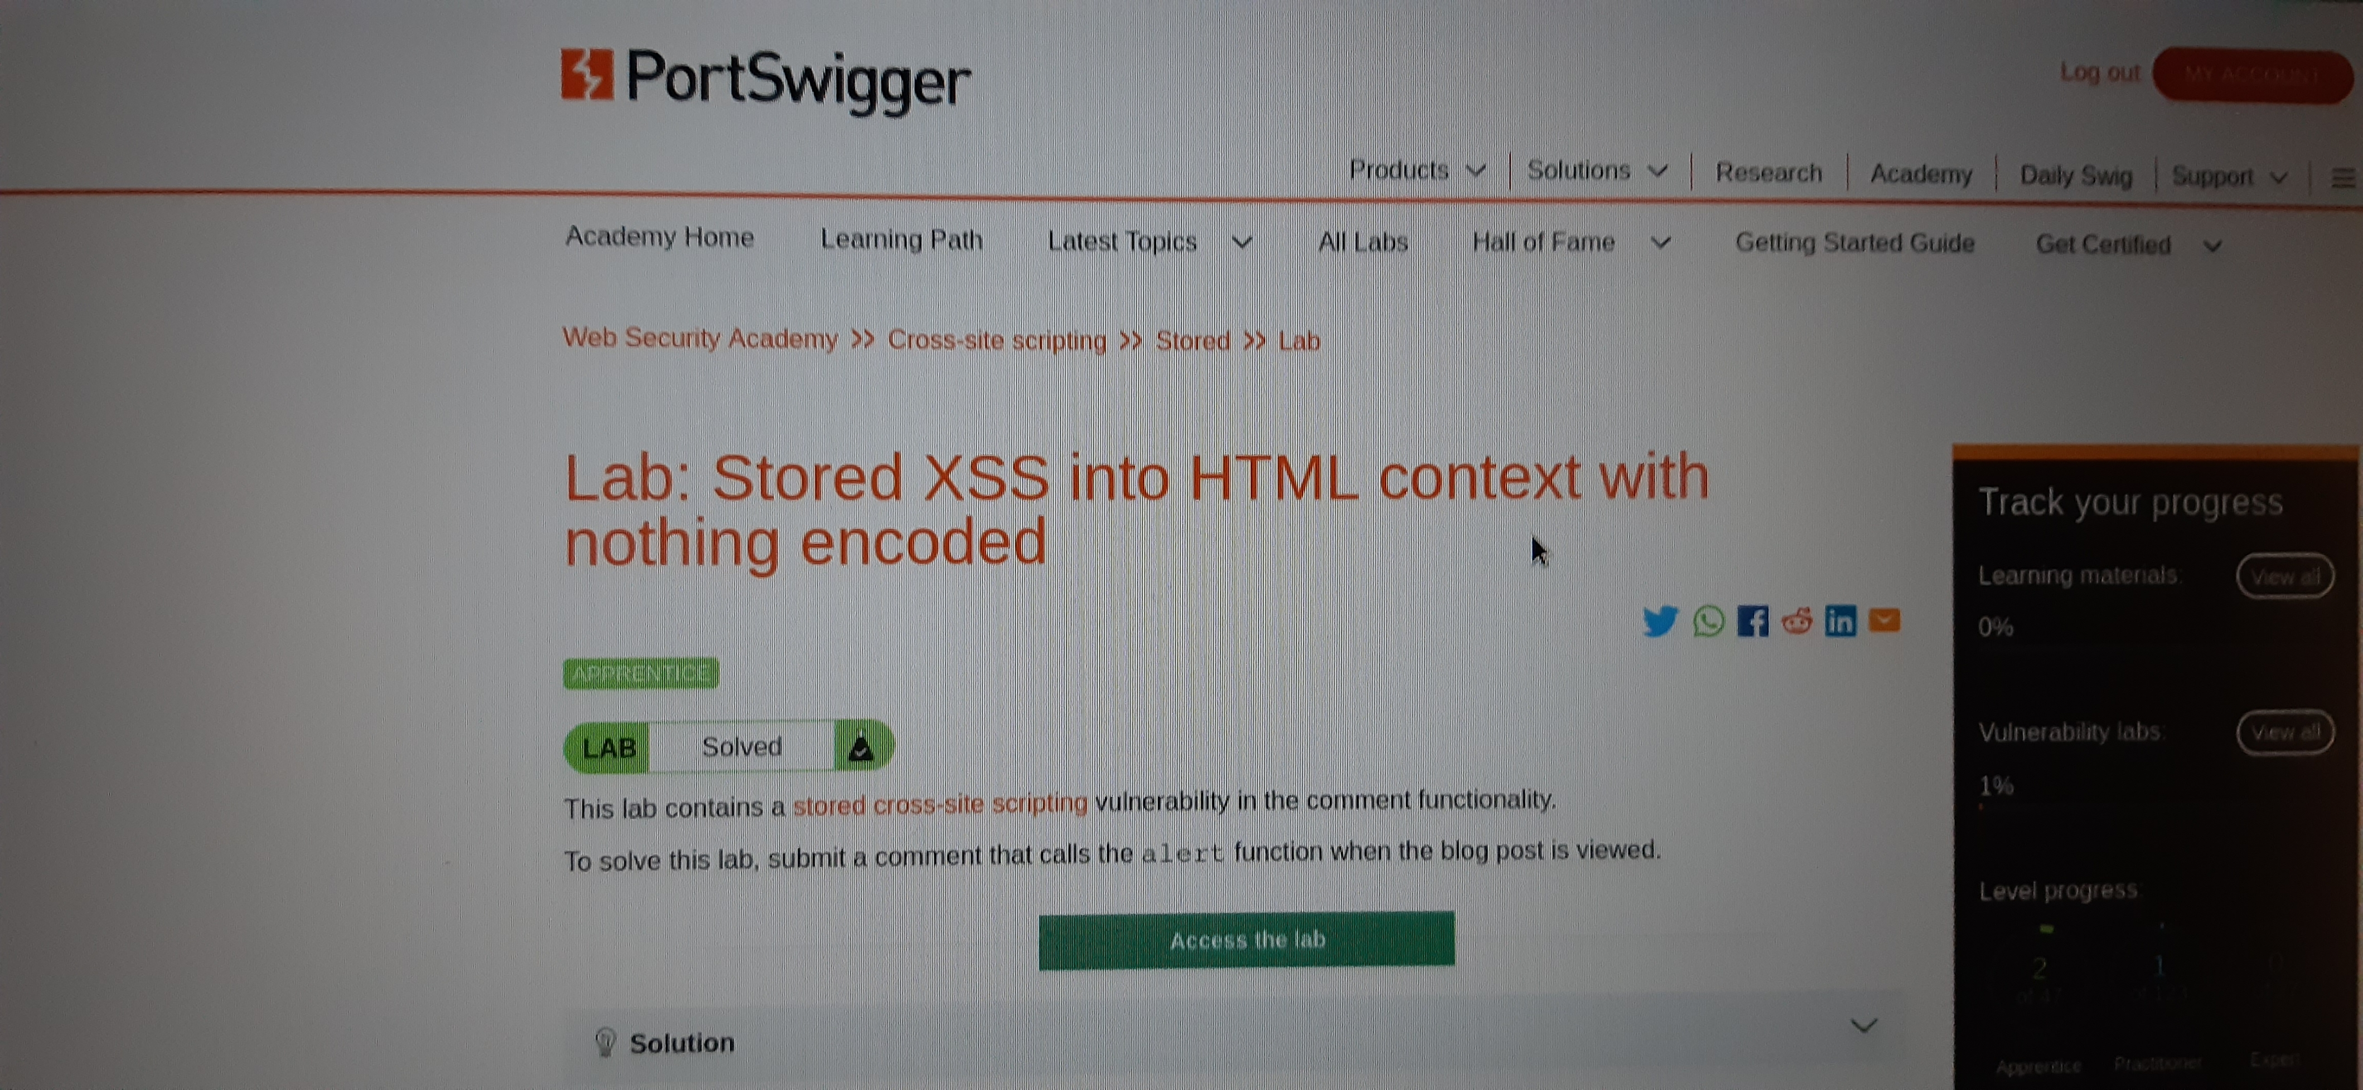

Slide 5
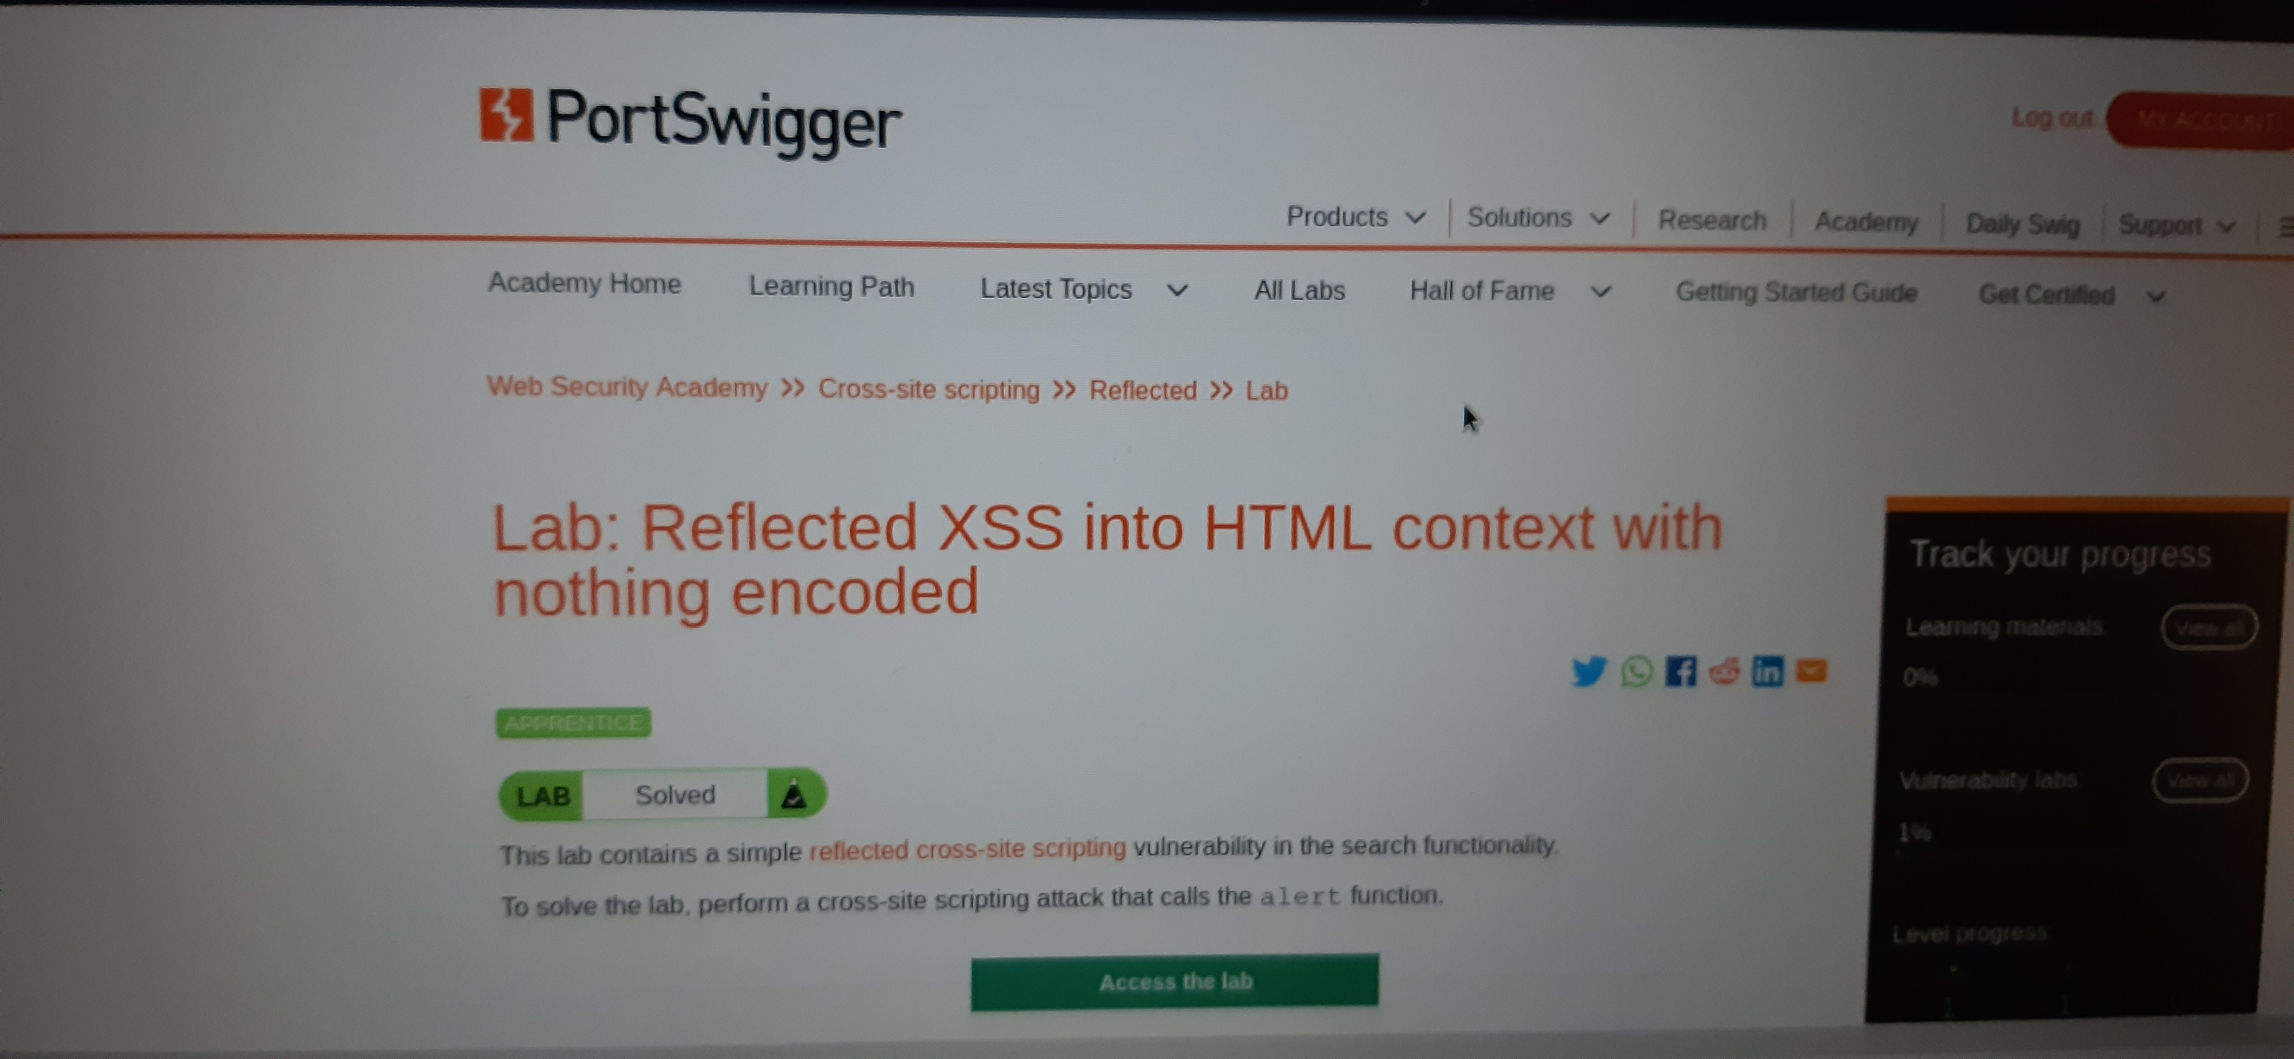

Slide 6
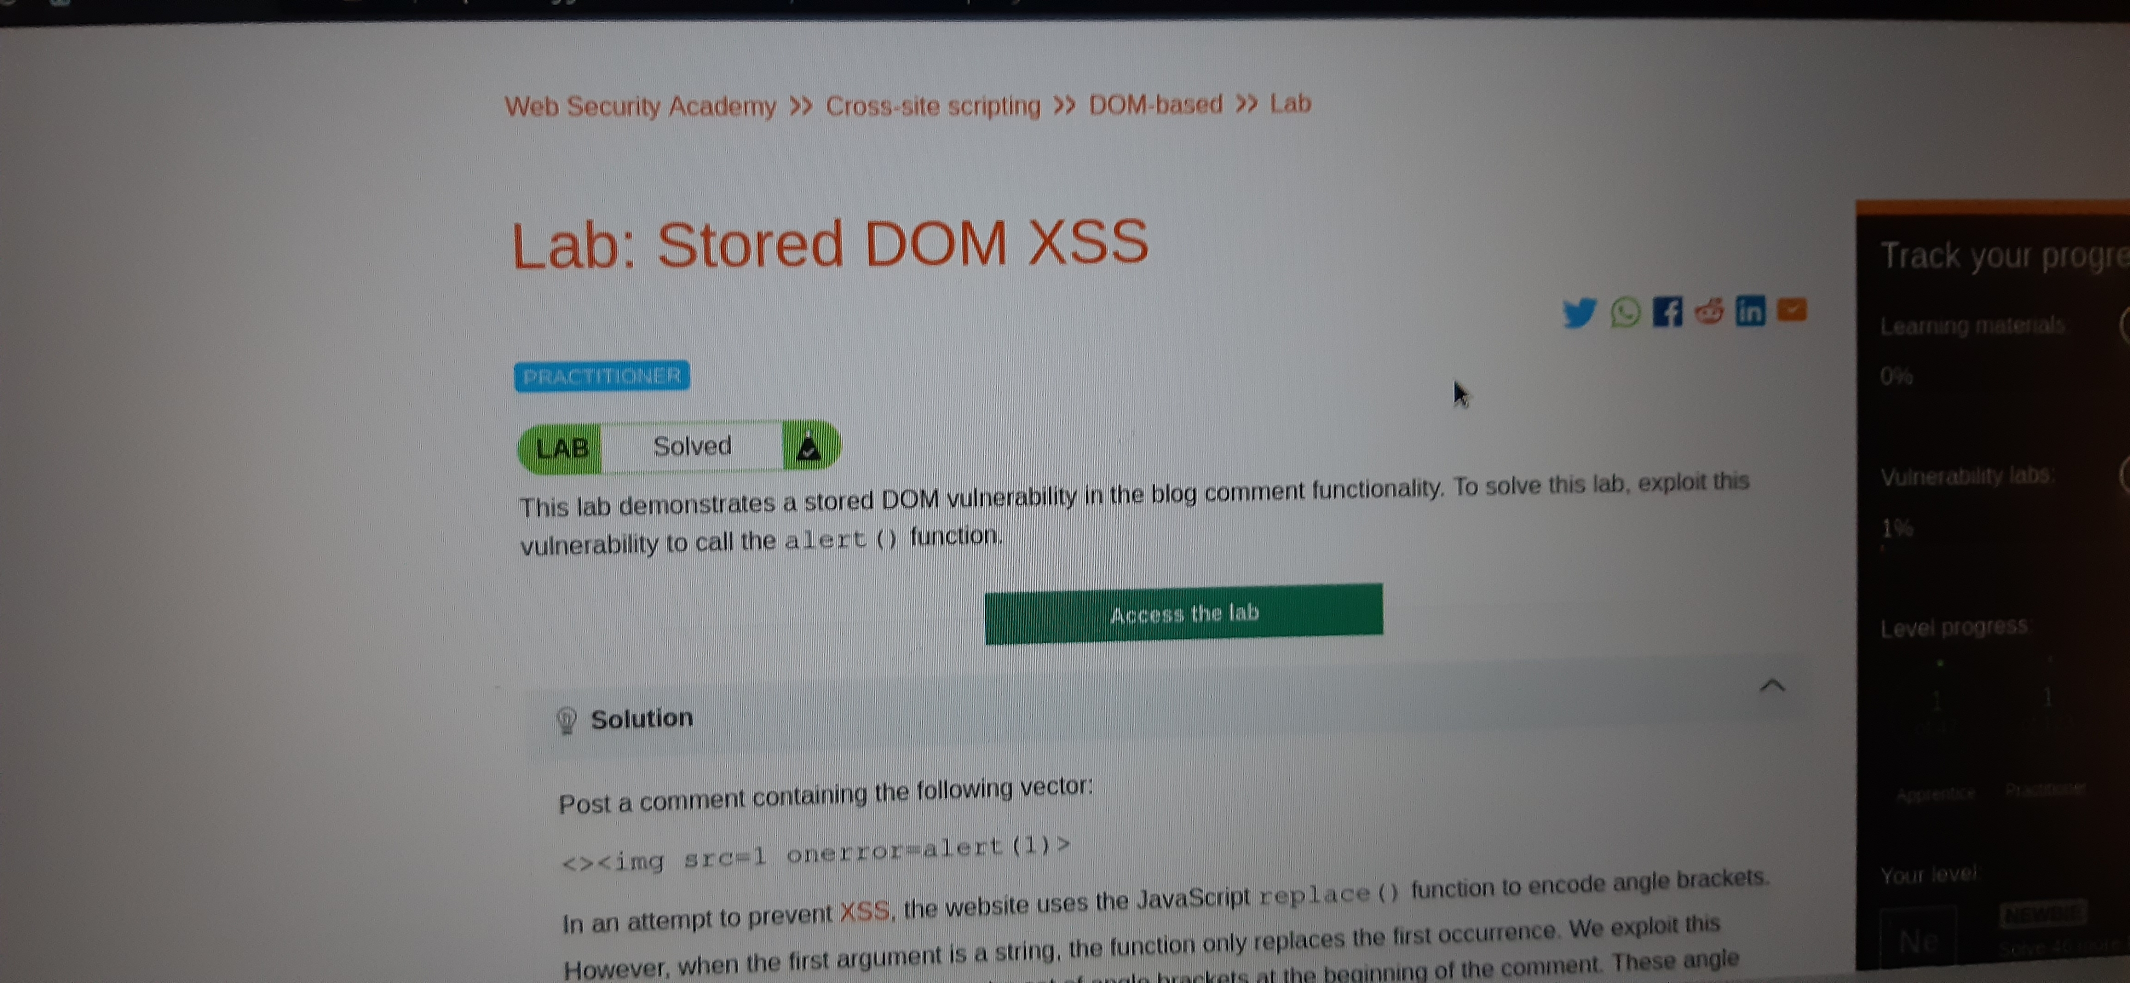

Slide 7
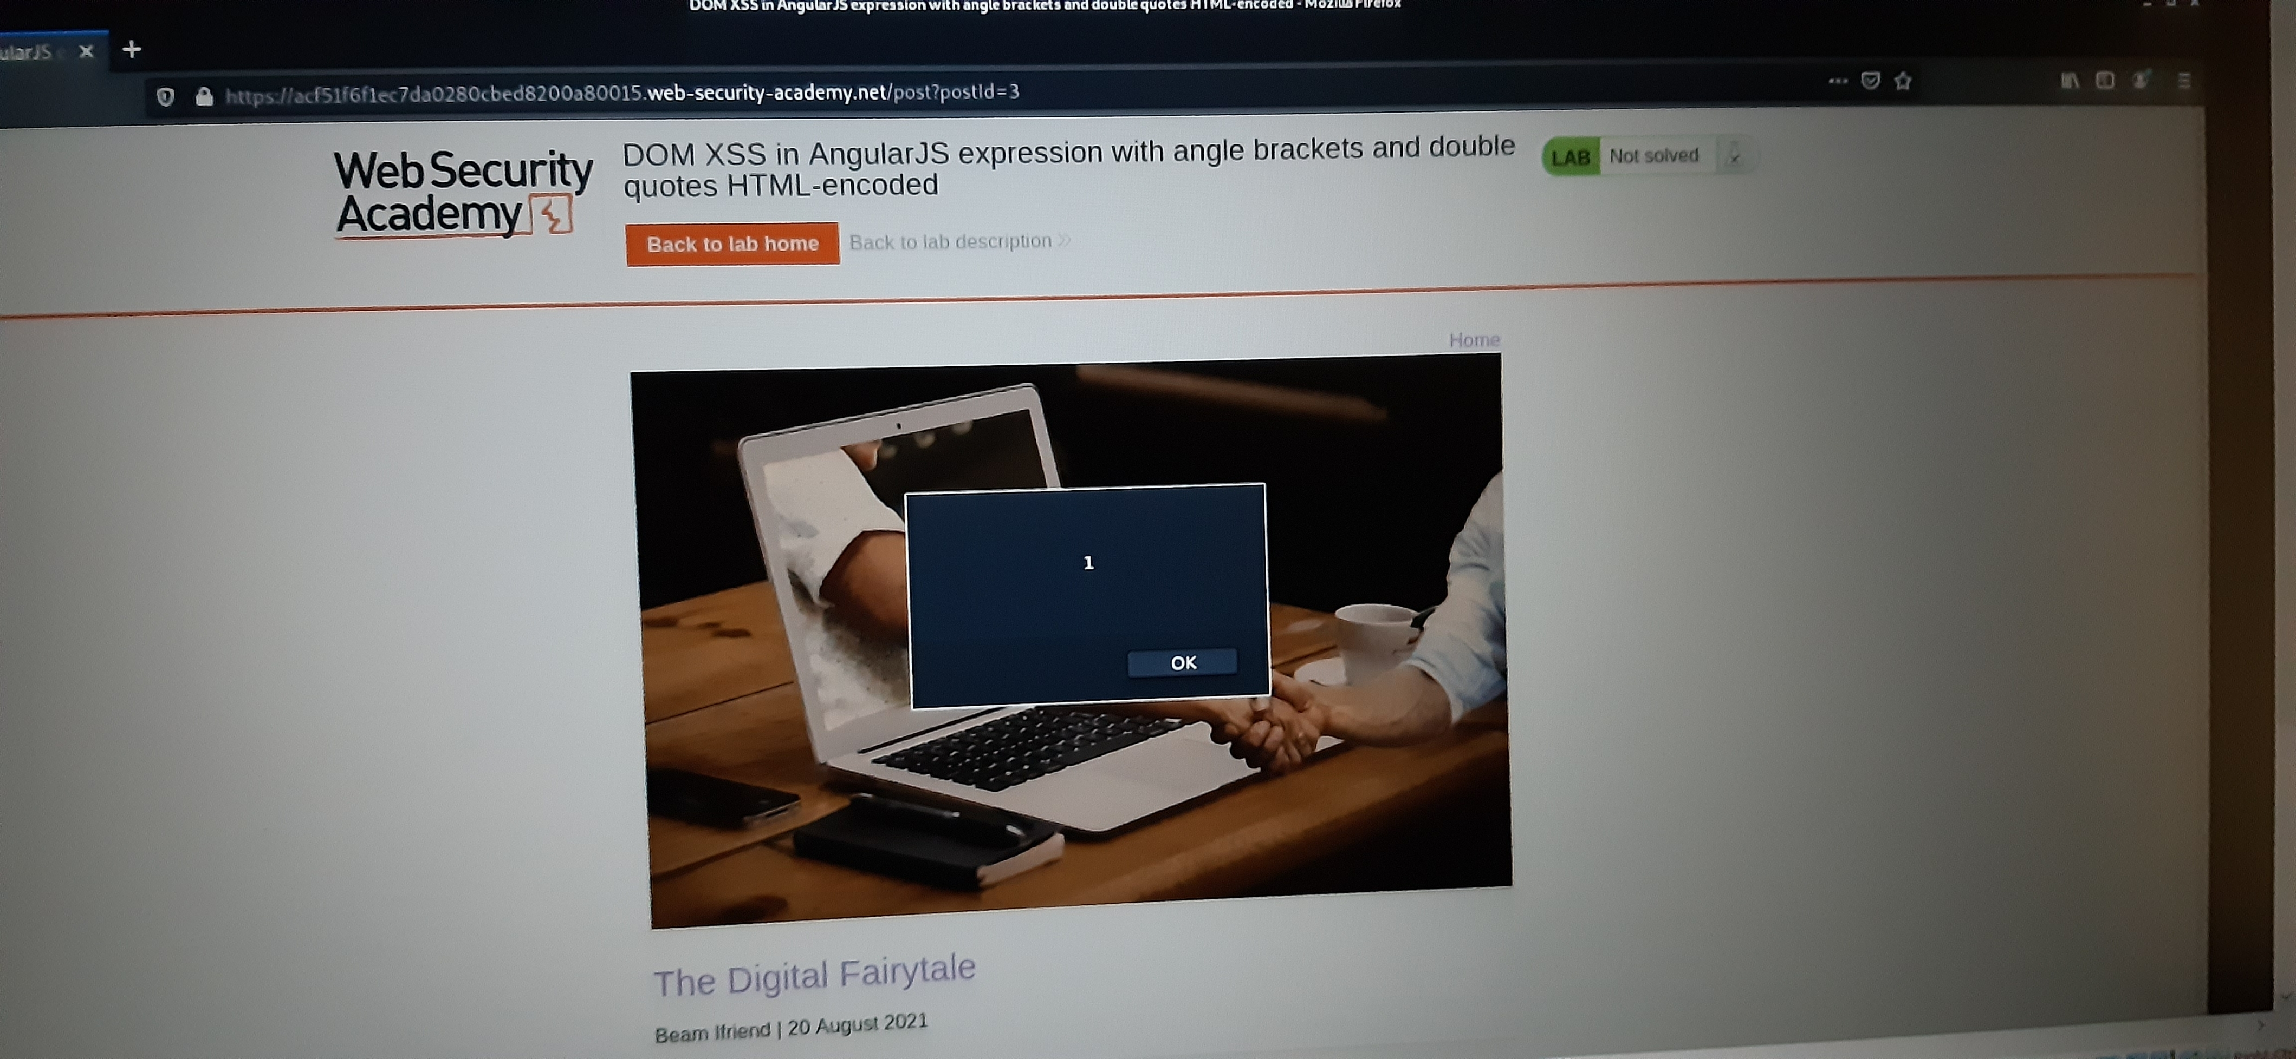

Slide 8
Task 2 Unable to download Netsparks .

Slide 9
Task 3

Slide 10
Report Title:Cross Site Scripting Domain:Vulnerable.com Subdomain:tests.vulnweb.com Steps : Step1:Visit http://tests.vulnweb.com/ Step2:On the top menu you will find a search option. Step3:Click on it and you will be prompted with a search box. Steps4:You can intercept the request in burpsuit. I have found several vulnerabilities with the above site.

Slide 11
Impact :Cross Site Scripting leads to stealing your user’s data and harmful for your website or organization. Since the security of the website is related with customers satisfaction,you should do some necessary changes. Mitigation:To make your website vulnerable from Cross Site Scripting just enable noscript on browser. You should always screen and validate any information input into data fields. Screenshots also included.

Slide 12
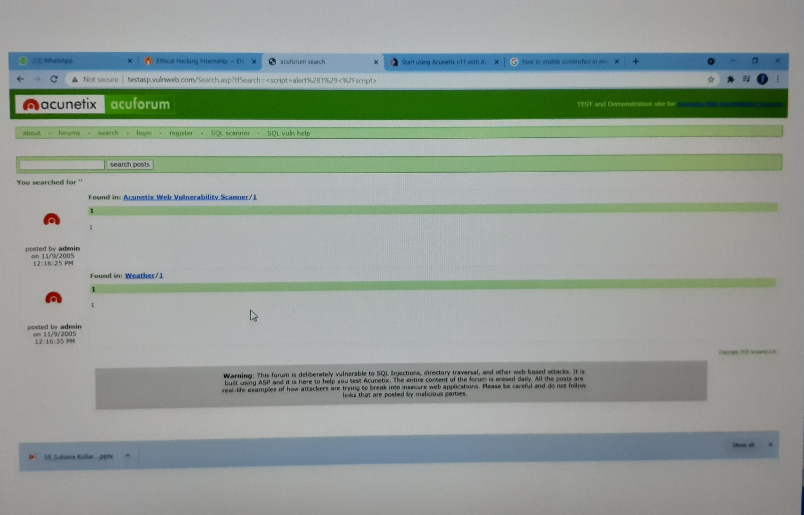

Slide 13
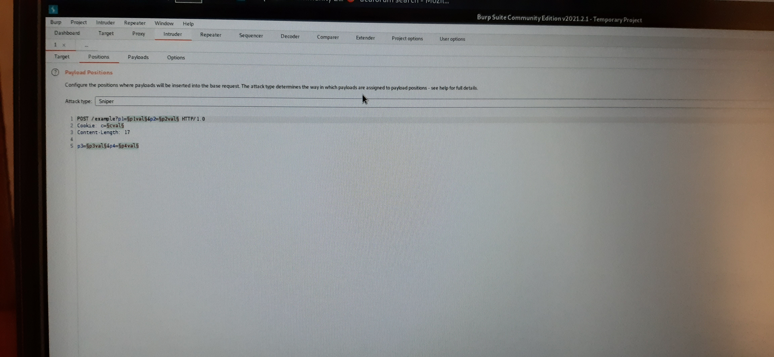

Slide 14
Thankyou

